Slide 1


UWA DATA ANALYSIS BOOTCAMP – PROJECT 3 Data visualization TEAM 5 proposal-2
https://johanfromesperance.github.io/Project-3-DataVisualization/index.html
Our Team
https://github.com/JohanfromEsperance
https://github.com/vn02063007
Johan Snyman
Minh Bui
Our Git Repository
https://github.com/JohanfromEsperance/Project-3-DataVisualization.git

Slide 2
Project 3-Data visualization Our team will select, analyze, extract, transform, load a dataset and visualize a dashboard and map for SPA state of the asset information: What are the asset conditions of our plant
Data Sources
Review
Inspect
Simulate
E
T
L
V
Exploration and Inspiration
Load
Visualize
Extract
Transform
Locate and download data
SPA- REDUX SAO CSV files
Use JSON and CSV
CLEAN and built JSOn file with Jupyter
Prework, structure, common keys, duplicates and NAN
Verify Data formats
Establish MAP and DASHBOARD formats
Design DASHBOARD
LOAD JSON and MAP
Load .CSV to Python and convert
Check CSV loaded correctly
API endpoints if required for maps
MAP API keys
Wrangling steps
Cleaning – NAN
Filter locations/FORMAT
Align location and usage
Rename headers
Remove columns
Save in SQL
Create and display WEB PAGE
PYTHON
LEAFLET
HTML
JAVA script
SQL
Check and Test Website
Load to PYTHON
Load to WEB
Check and test data
Config
CSS
Leaflet
JS
JSON
SQL

Slide 3
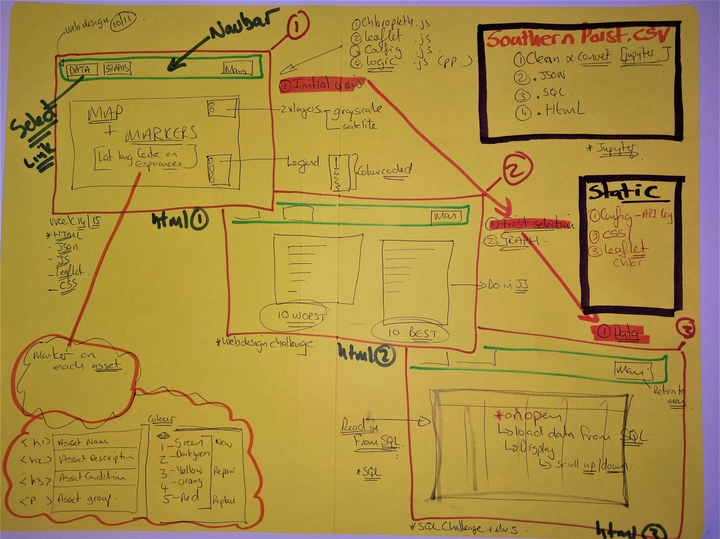
Week13,Project 2,Week14,Week 15
Project 3-DESIGN
Base-map and one overlay
Southern Ports Datafile
Use ESPERANCE
Filter and Clean in Jupyter
TOP 10 Asset List
Relation Ship diagram
Clean and load to SQL version
Select Tob 10 assets
BARCHART to WEB page 2
HTML – INDEX
App.js
CSV Read in, Clean
CSV - JSON
LEAFLET
CSV Manipulations
OVERLAY
MARKERS
Marker data setup
See next page
Week15
LOAD and READ SQL link
Connect Link to HTML
Upload to WEB Page 3
LEGEND for condition data
Upload SQL file to WEBPAGE
Week8,9,19-0, Project2
Johan
Minh
https://johanfromesperance.github.io/Project-3-DataVisualization/

Slide 4

Project 3-Sketch

Slide 5
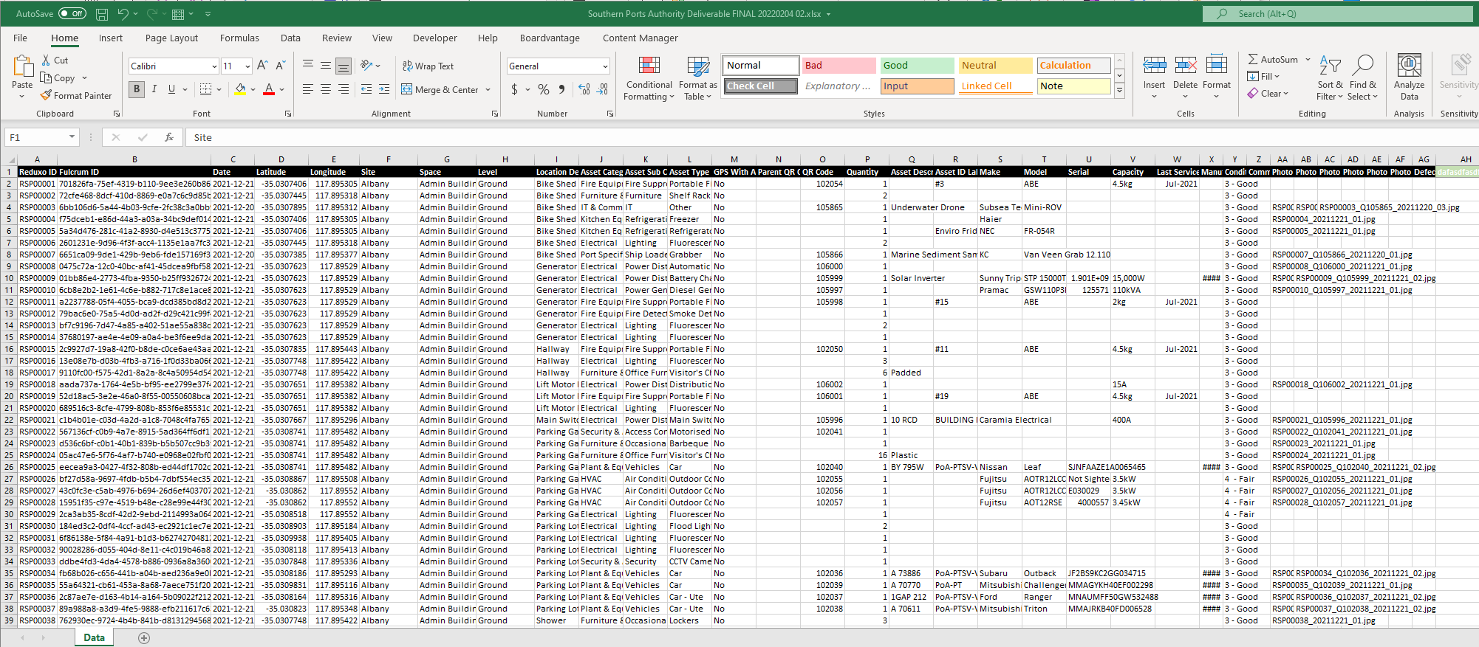
Extract and data sample
Data Sets
Datasets Sourced From – Southernports SAO.CSV
File A – SPA-Zip dataset
Will limit the design to the first 250 datapoints
Will filter for the top 10 WORST assets – TOP 10 BEST assets – display in a BARCHART on WEB PAGE 2

